Slide 1
Monthly Limits & Deposits Tracking Report
Citi Finance
March 2023
Notes:
‹#›

Slide 2
Introduction
This report covers deposits and loans extended to entities 1,2, and 3
Deposit and loan positions for Jan 2023 and February 2023
We will analyze key financial indicators and identify any breaches of Early Warning Triggers (EWT) and Management Action Triggers (MAT)
We will visualize the trends in surplus and stressed surplus

Slide 3
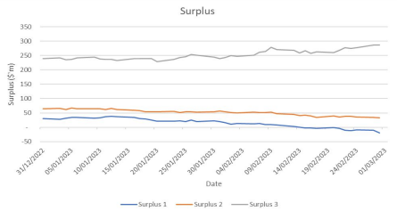
Risk Triggers Monitoring
Deposit dropped by more than 3%:
Entity 1 on 1/20/23, 2/2/23 and 2/28/23
Entity 2 on 1/24/23, 2/1/23, 2/2/23, 2/14/23 and 2/28/23
Entity 3 on 1/20/23
Loan increased by more than 5%:
Entity 1 on 1/6/23 and 2/13/23
Entity 2 on 1/17/23, 2/13/23, 2/17/23 and 2/21/23
Entity 3 on 2/2/23 and 2/14/23
Surplus dropped to below half of last year’s closing position:
Entity 1 from 2/2/23 until 2/28/23
Entity 2 on 2/28/23
Daily surplus positions for entities 1,2, and 3 from December 31, 2022 to February 28, 2023 are shown above
Surplus for entity 1 dropped below 0 from February 15, 2023

Slide 4
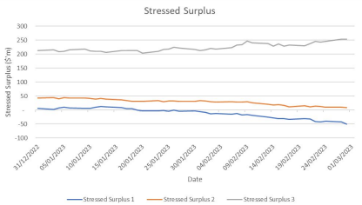
Risk Triggers Monitoring (cont.)
Management Action Trigger:
The stressed surplus dropped below zero for Entity 1 from 2/15/23 until 2/28/23
Actions should be considered for this case
Daily stressed surplus positions for entities 1, 2, and 3 from December 31, 2022 to February 28, 2023 are shown

